Slide 1
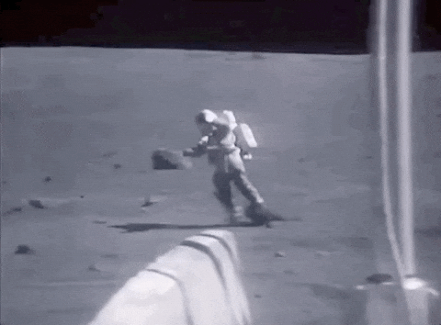
Analytical Walking Models + RL towards Less Painful Biped Walking Policies
Noah Fisher and Daniel Levine

Slide 2
Training walking policies is hard and opaque for model free. Creating walking controllers is tedious and often fragile using classical methods. Can we create a classical foundation for baseline ability, and use RL to provide robustness?

Slide 3
To Answer This Question:
Linear Dynamics Models for Walking
Quadratic Cost
Closed Form Expressions → Derive LQR Baselines
Introduce Unmodelled Noise
Train (Ideally) Using Structure but with perturbations
Compare Baseline Analytic Controllers to RL Policies (in progress)

Slide 4
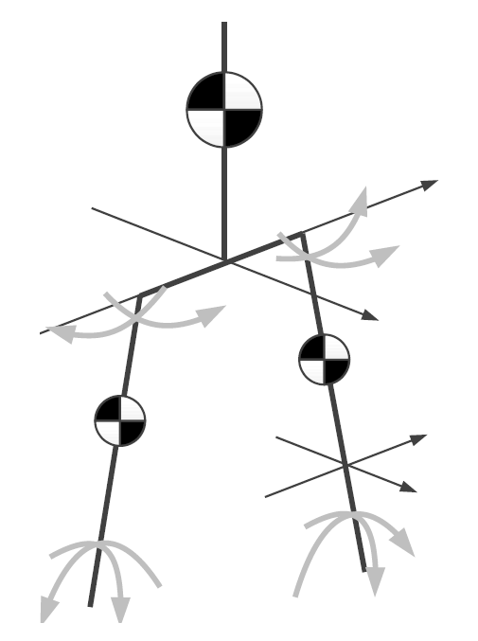
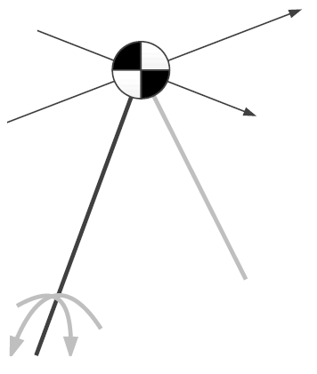
Our Linear Template Models: LIP, 3LP
LIP, Kajita 1991
3LP, Faraji 2015
3LP is a three linearized pendulum extension for swing dynamics.

Slide 5
3D LIP

Slide 6
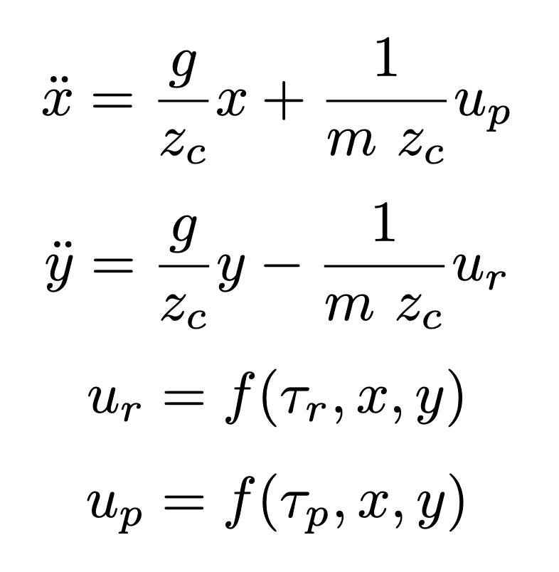
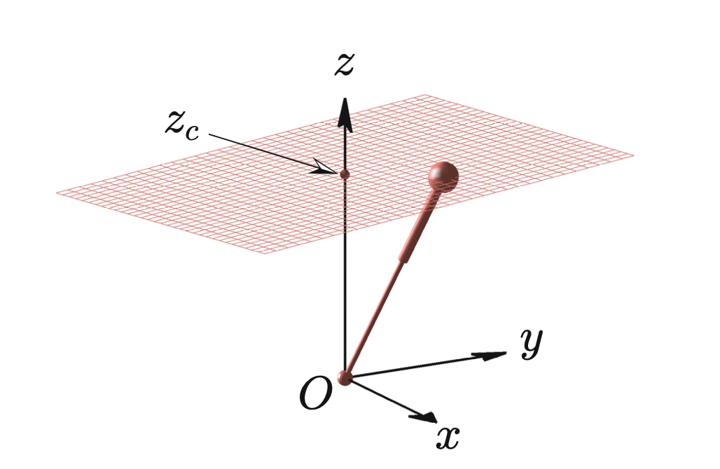
LIP Dynamics

Slide 7
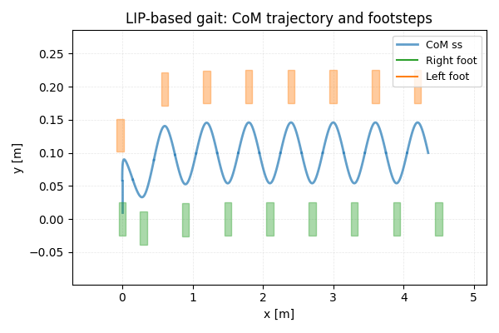
Generating a Walking Pattern
Notes:
By defining step size, single support period, and the orbital energies, we can compute a stable periodic walking pattern!

Slide 8
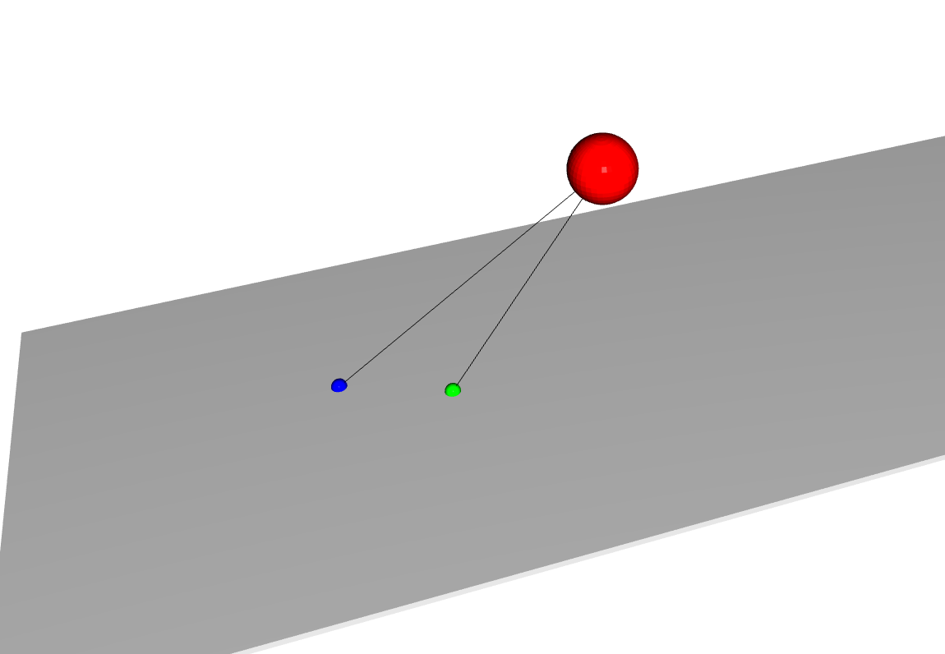
However, the Trajectories are Unstable Equilibriums
Notes:
However, much like a ball sitting at the top of a hill, these walking patterns become unstable with the slightest of nudges

Slide 9
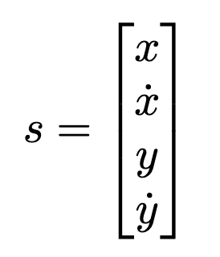
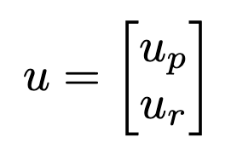
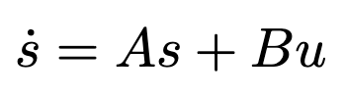
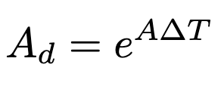
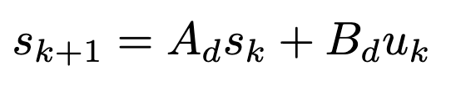
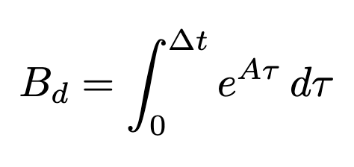
Closing the Loop Part 1: Discretization (ZOH)
Notes:
State Space → ZOH Discretization. A, B come from linear dynamics

Slide 10
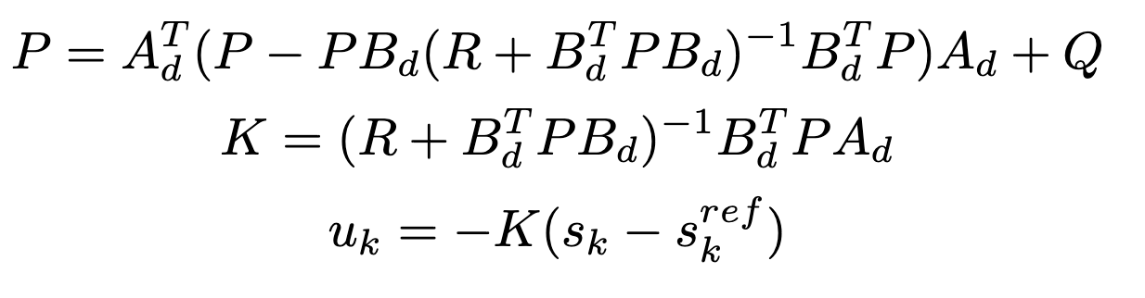
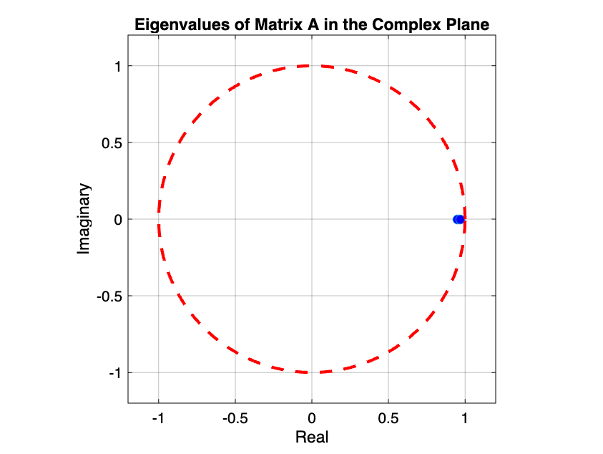
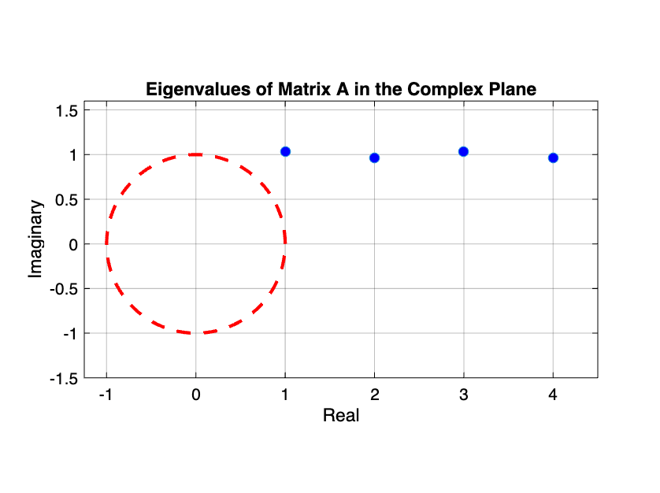
Closing the Loop Part 2: LQR and the Riccati

Slide 11
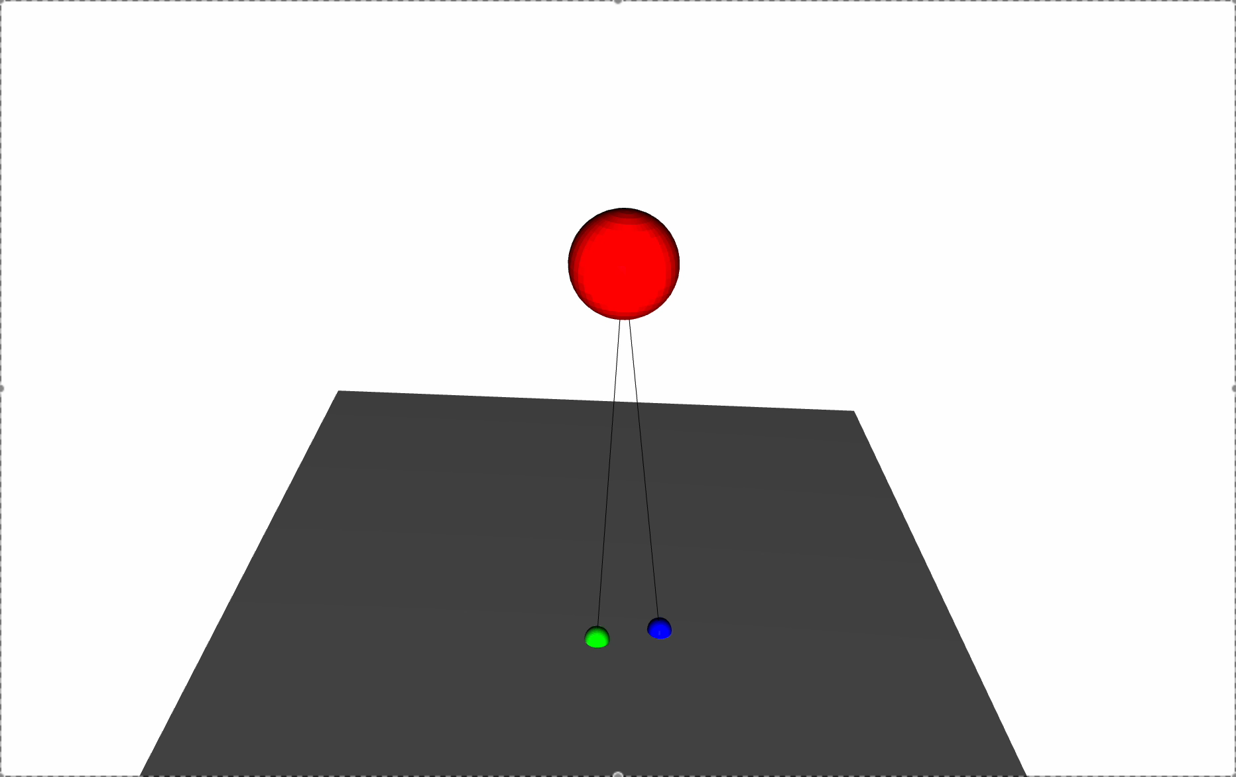
Our Gait is Stable for Random Disturbances!
Notes:
Footstep error (unknown to controller) generated via gaussian noise

Slide 12
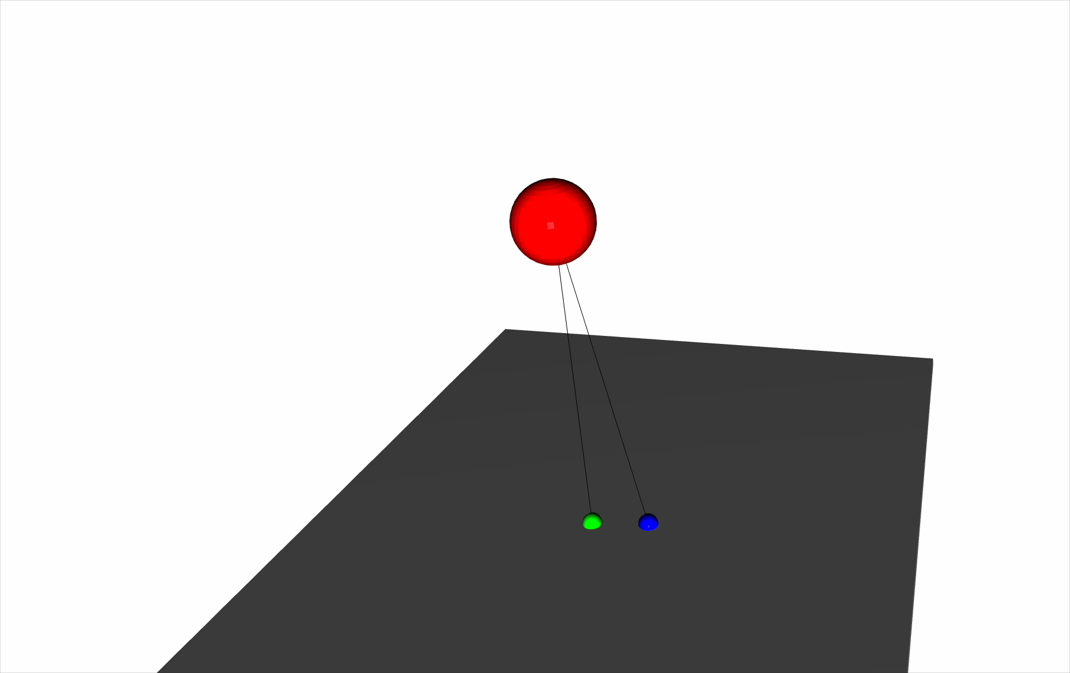
But NOT Stable for Noisy Footsteps :(

Slide 13
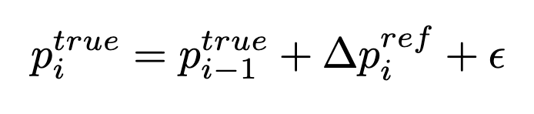
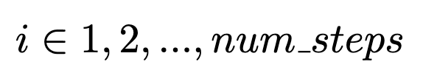
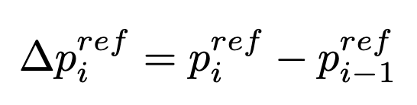
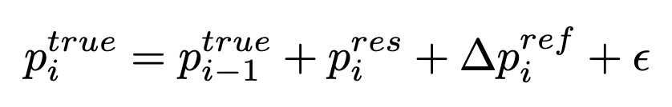
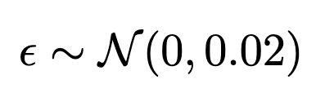
Problem: We don’t observe footstep error, and it’s difficult to model
Solution: Use RL to compute a residual for foot placement!
RL!

Slide 14
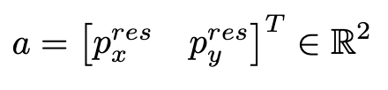
LIP RL Setup
Goal:
Robustly track reference trajectory even noisy steps
State:
Action:
reward
Defined using error coordinates from ref gait

Slide 15
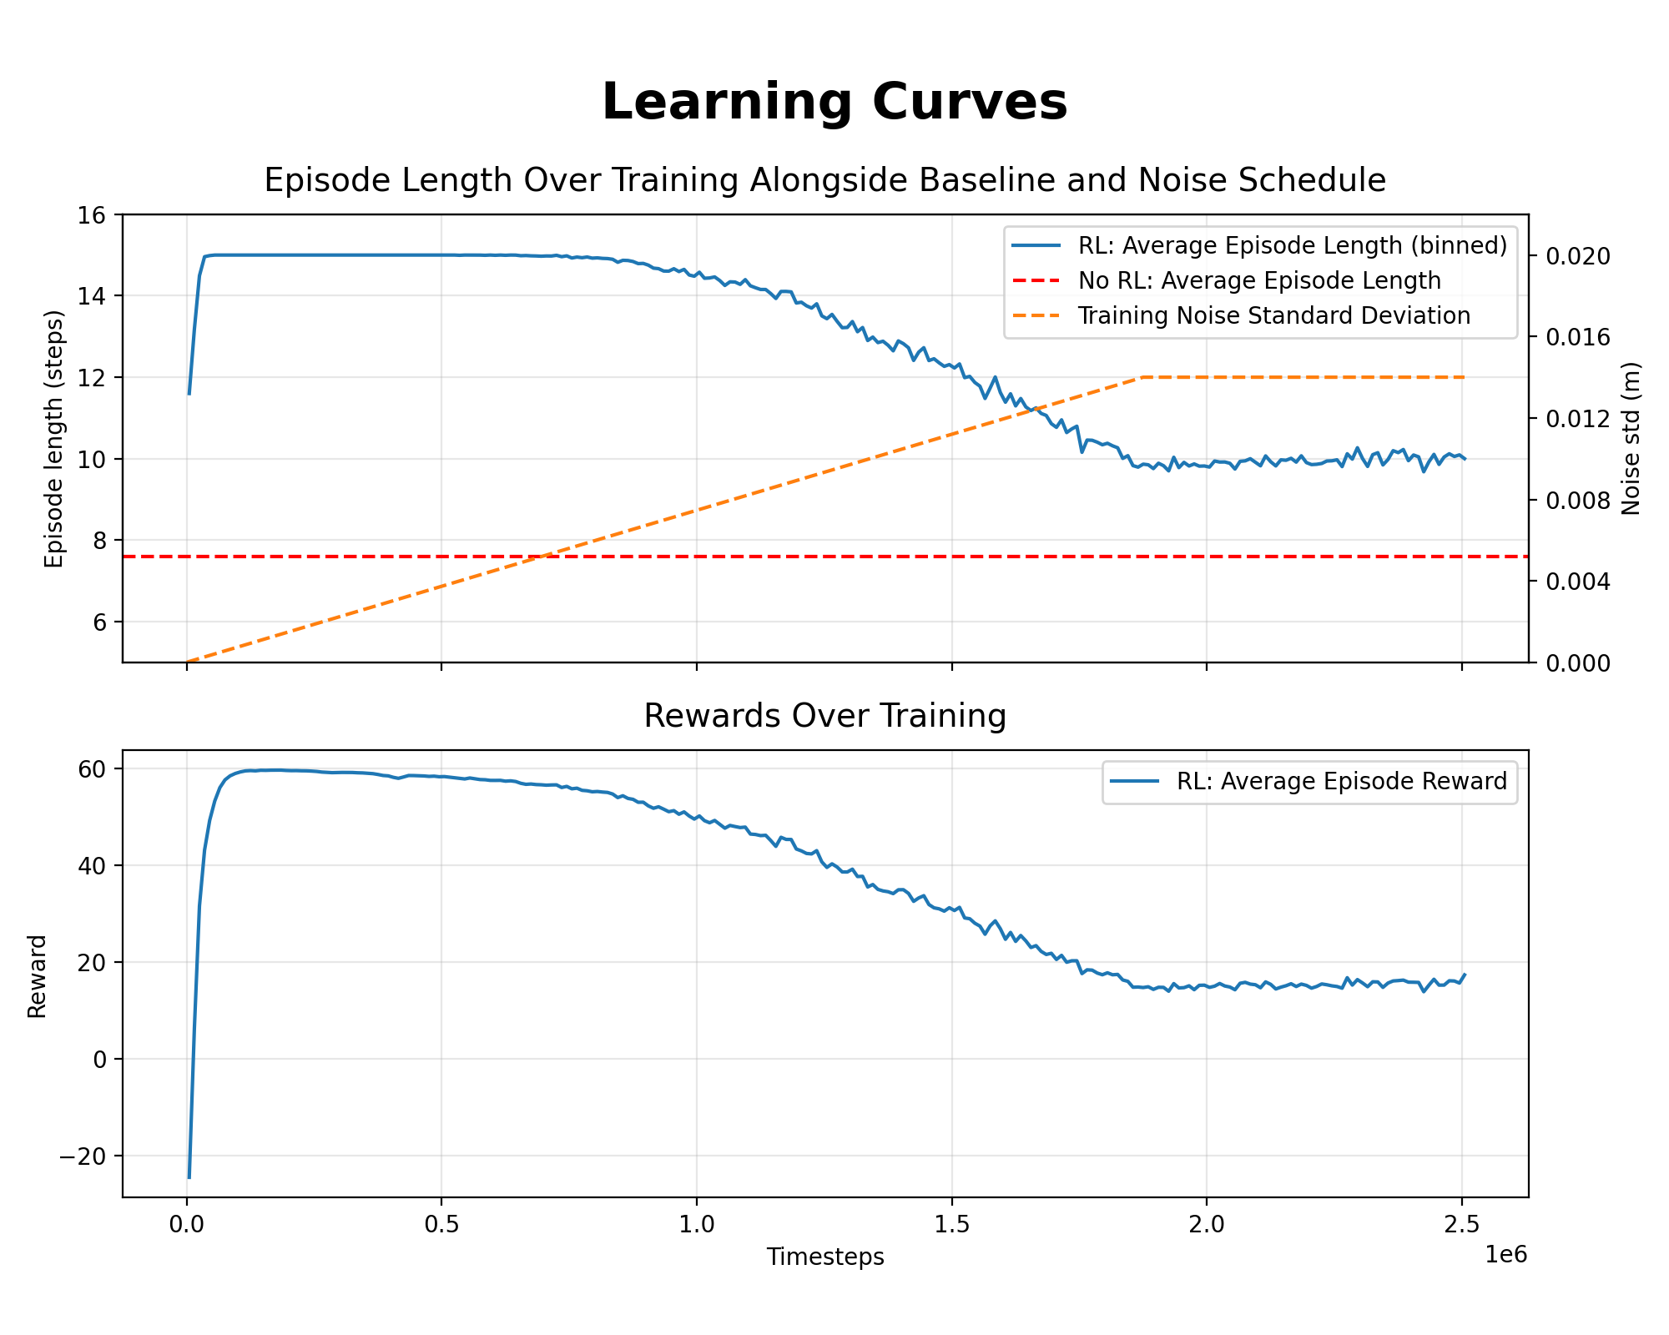

Slide 16
3LP

Slide 17
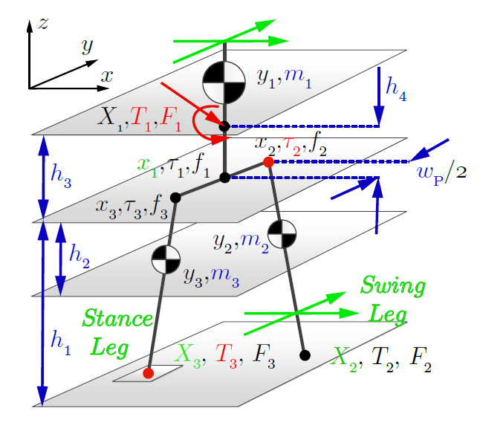
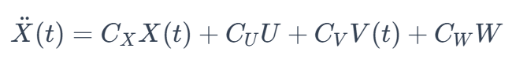
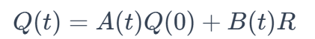
3LP Dynamics
Model
Linear! (but ugly)
3 Linear Pendulums
Constant and ramped ankle and hip torques
Closed form solution for gait gen and control
Notes:
Cite faraji for the dynamics

Slide 18
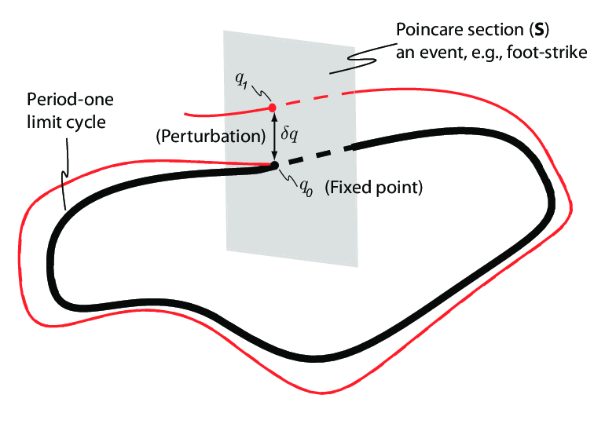
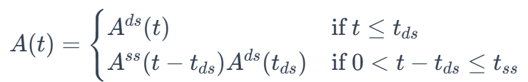
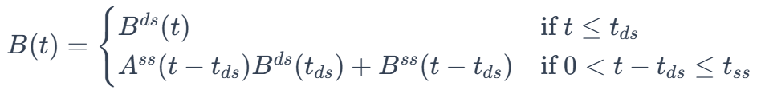
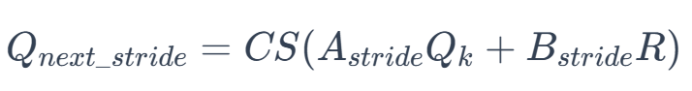
Two Phases: Hybrid Model → Total Stride Map
Total Stride Map (closed form dynamics)
Apply a Foot Swap and Centering “Reset” matrix to make every cycle appear the same math-wise.
If stable,
always look the same
Notes:
https://www.researchgate.net/figure/A-Poincare-Map-is-used-to-find-walking-solutions-and-to-analyze-stability_fig1_322069775

Slide 19
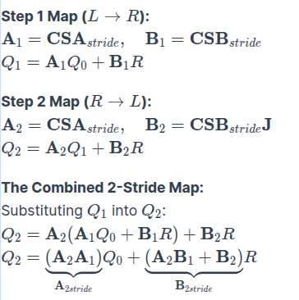
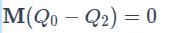
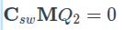
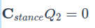
Use the Stride Map + Nullspace Conditions for Reference Gait
For Symmetric, Periodic Gait, Solve for Limit Cycle over 2 Full Strides (L,R,L)
Write out the double stride map
2. Solve limit cycle torques for double stride map via null space equations:
Periodicity - Rel Pos of limbs are the same at boundaries
Symmetry - Swing foot has zero vel relative to stance foot at impact
No Slip - Stance foot must have zero vel

Slide 20
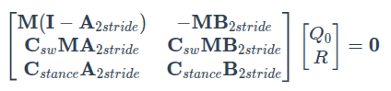
Use the Stride Map + Nullspace Conditions for Reference Gait
Null Space Solve:
And then we solve a QP to select the minimum energy gait to achieve the target speed, ds and ss parameters.

Slide 21
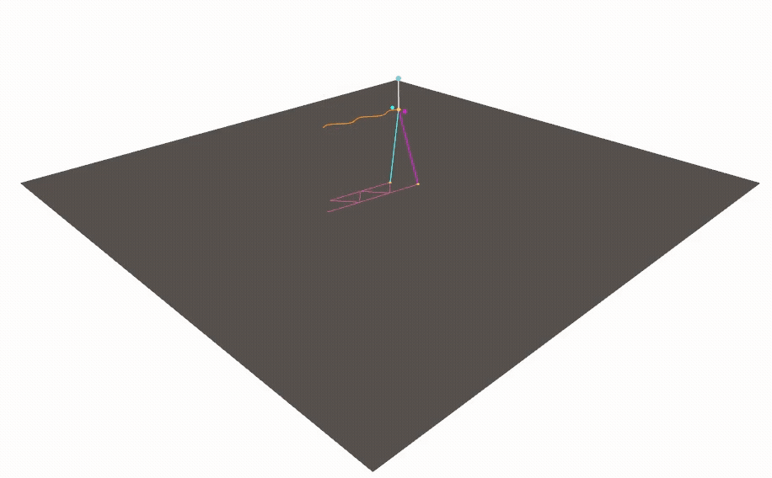
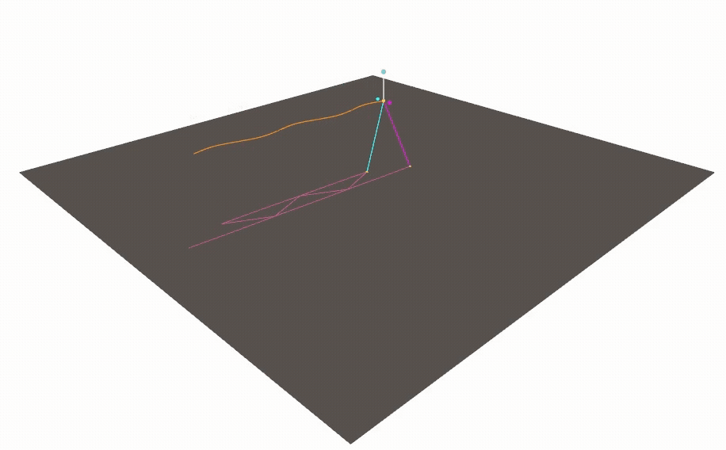
Reference Gait Generation From Selected Nullspace Criteria
Speed:0.4 m/s
Step Time: 0.1s ds, 0.6s ss
Speed:1.2 m/s
Step Time: 0.1s ds, 0.6s ss

Slide 22
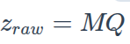
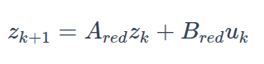
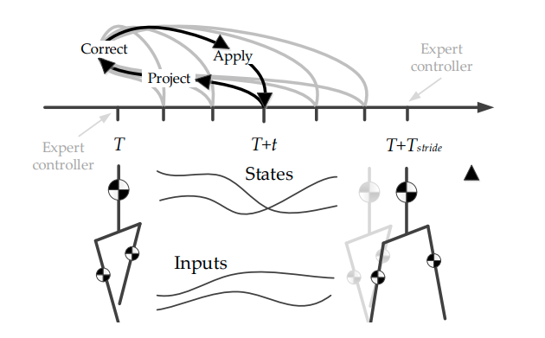
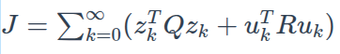
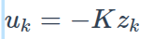
DLQR and Time Projection Controller
DLQR - Correction Once Per Stride
Standard discrete LQR procedure, using the stride map dynamics (reduced state to moving pelvis and foot via M).
Solved via fixed point iteration due to repeated eigenvalues. Decomposition methods numerically fail.
As we are stabilizing the poincare map, this is once per stride.
DLQR + Time Projection – Run it back!
Extension of LQR for continuous control by projection of error to boundary for DLQR (Faraji 2017)

Slide 23
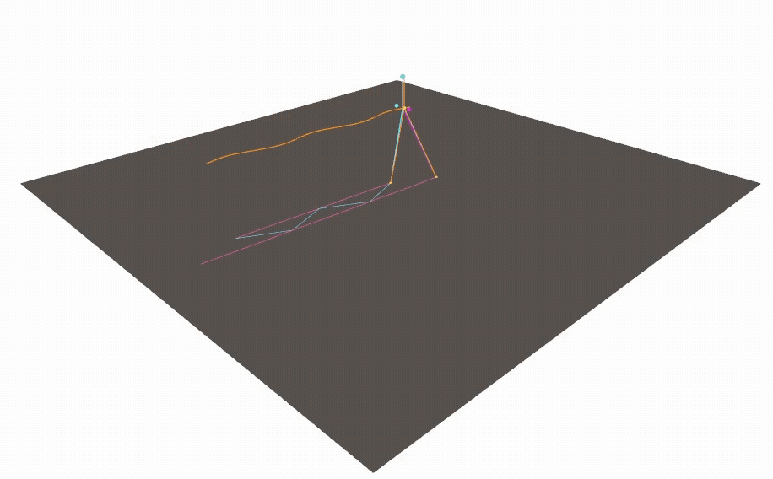
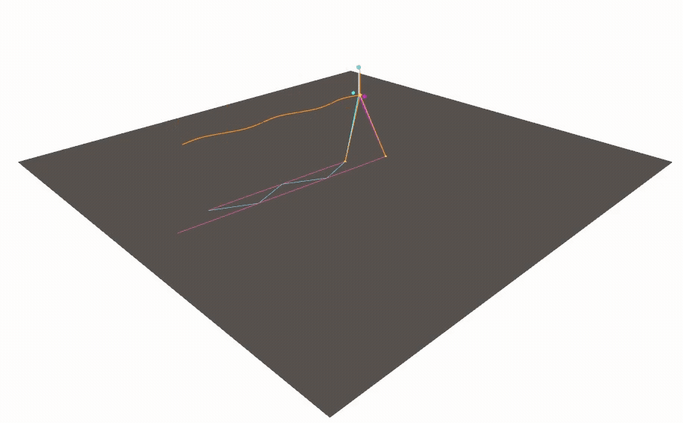
Open Loop vs. DLQR Time Proj. 5 cm Perturbation
Open Loop (1.2m/s)
Time Projection DLQR (1.2m/s)

Slide 24
OK! Stabilizing 3LP is not hopeless.

Slide 25
3LP RL Setting On Policy Stochastic Actor Critic, TD(0)

Slide 26
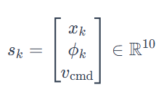
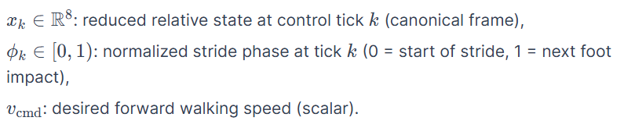
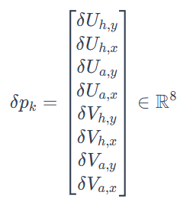
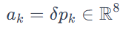


3LP RL Setting
(Designed for Actor Critic)
State:
Actions:
Small change torques applied to hip and ankle
Transition Dynamics:

Slide 27





Parameterization for Actor Critic
Originally Designed for Stride Level Control – But using linear controllers could not stabilize using DLQR alone → aimed to use policy w/more frequent actions
State Error Coordinates Relative to Reference Trajectory:
Actor Parameterization: Linear Combination of Error Coordinates → Linear state feedback policy

Slide 28




Critic Parameterization: Linear Combination of Quad Monomials
Critic Parameterization: Linear Combination of Quadratic Monomials
Using error coordinates z_k as for actor parameterization:

Slide 29







Reward (Cost) Function and Termination
Reward: Formulate like negative LQR Cost
Termination: ”Fall”
Pelvis moves too far from stance foot
Pelvis velocity exceeds a threshold
Large discrete negative reward

Slide 30
In practice – AC stalled, PPO

Slide 31

In progress – but PPO also stalled

Slide 32

Residuals and Torques Looks Reasonable, But Policy is Poor

Slide 33

Residuals and Torques Looks Reasonable, But Policy is Poor

Slide 34
Conclusions

Slide 35
Insights
Even with all the structure we built up, for walking in this precise manner – learning residuals was still not easy. The unstable system wants to be unstable. This was surprising.
LQR, even for a difficult Poincare-map system, works decently (though also a bit fragile)
If for a linear system LQR doesn’t work – likely RL won’t either. (RL is LQR!)
For all the cleverness with linear combinations – MLP’s and PPO seem just as good.
We want the RL part to really work for the report!

Slide 36
Lastly,
We had fun and learned a lot!
Thanks all!

Slide 37
Sources
Kajita, S. (2017). Linear inverted pendulum-based gait. In Humanoid robotics: A reference (pp. 1-18). Springer, Dordrecht.
Faraji, S., & Ijspeert, A. J. (2017). 3LP: A linear 3D-walking model including torso and swing dynamics. the international journal of robotics research, 36(4), 436-455.
Faraji, S., & Ijspeert, A. J. (2016). A new time-projecting controller based on 3LP model to recover intermittent pushes. arXiv preprint arXiv:1605.03039.

